Slide 1
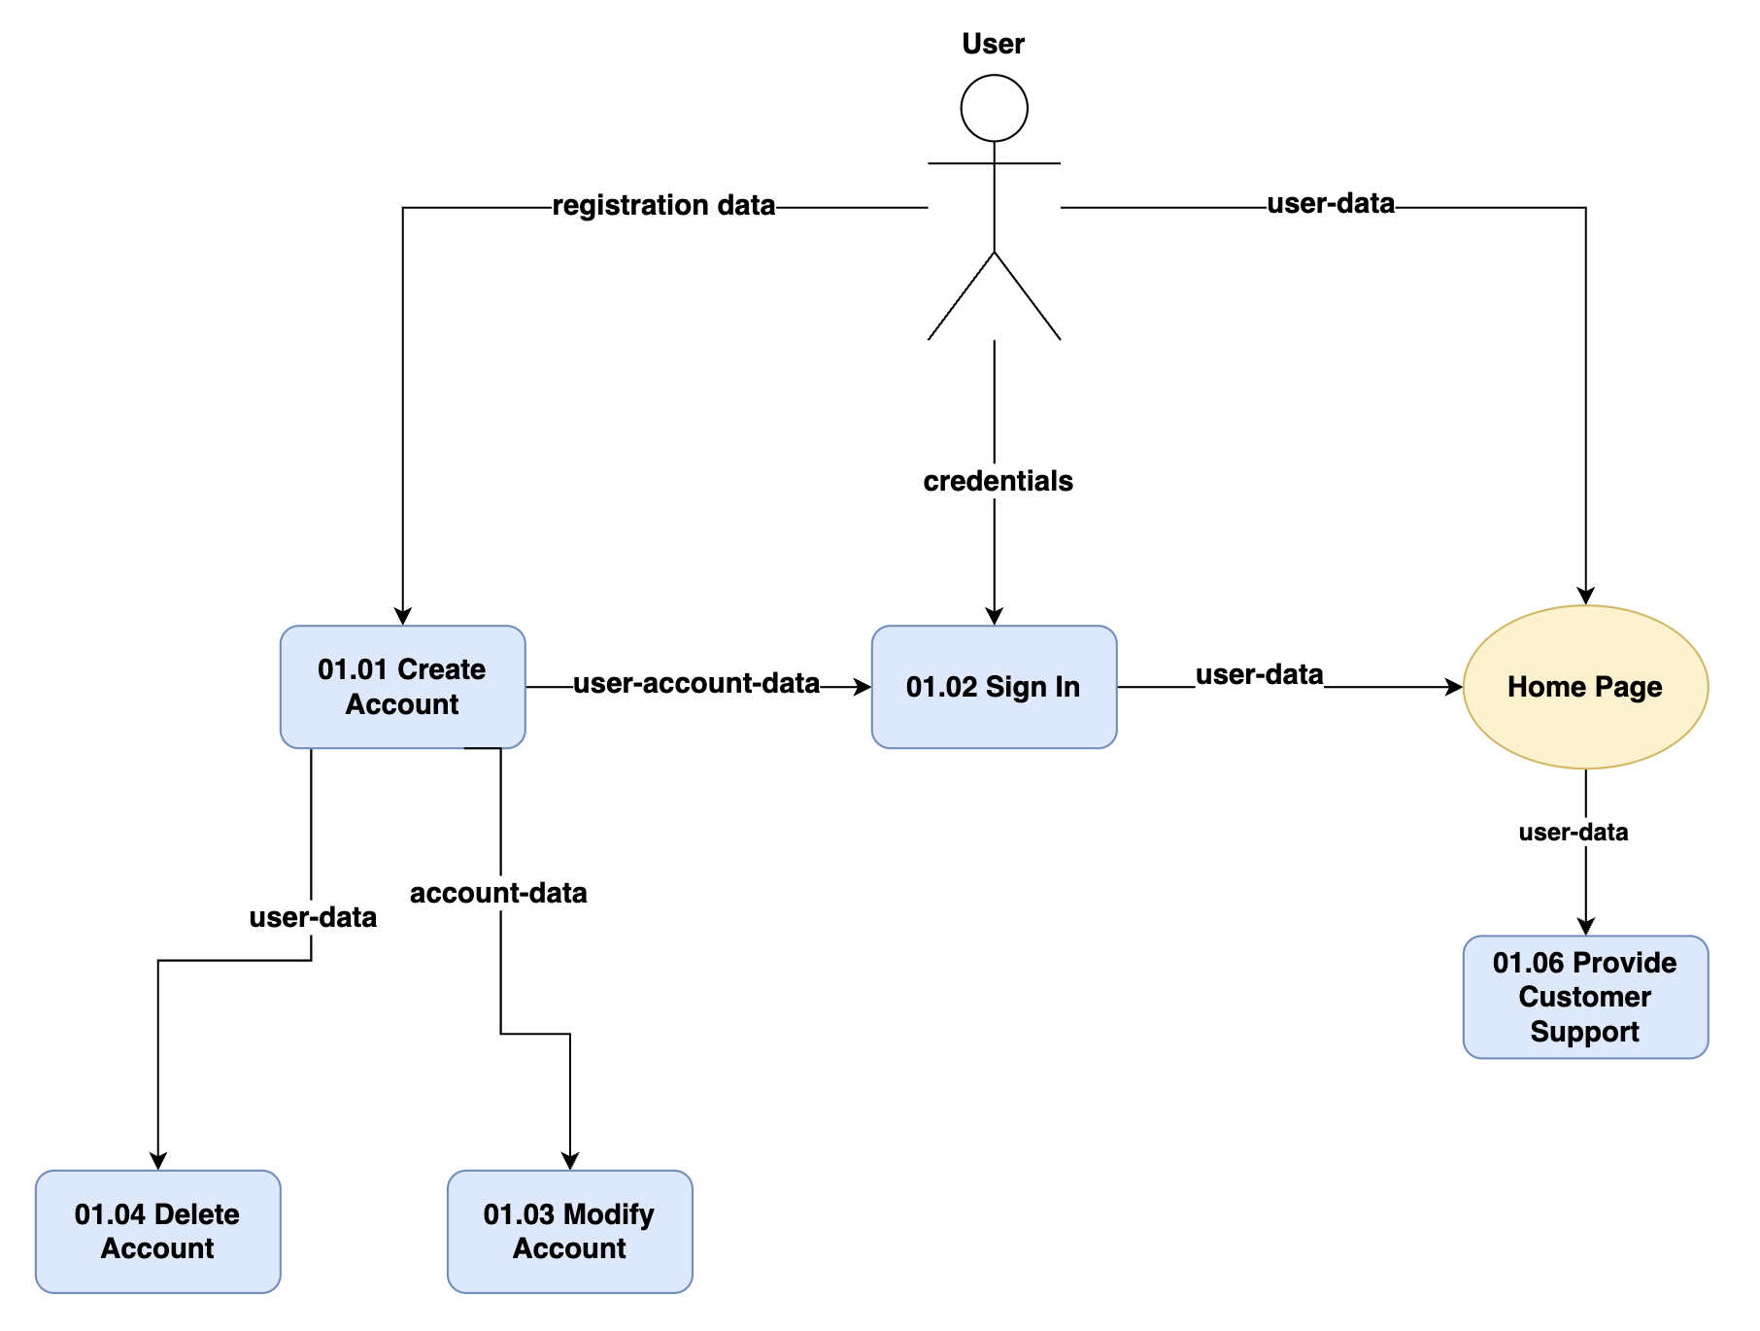
Team4 - Reviewer
Data Flow Diagram (Logical)

Slide 2
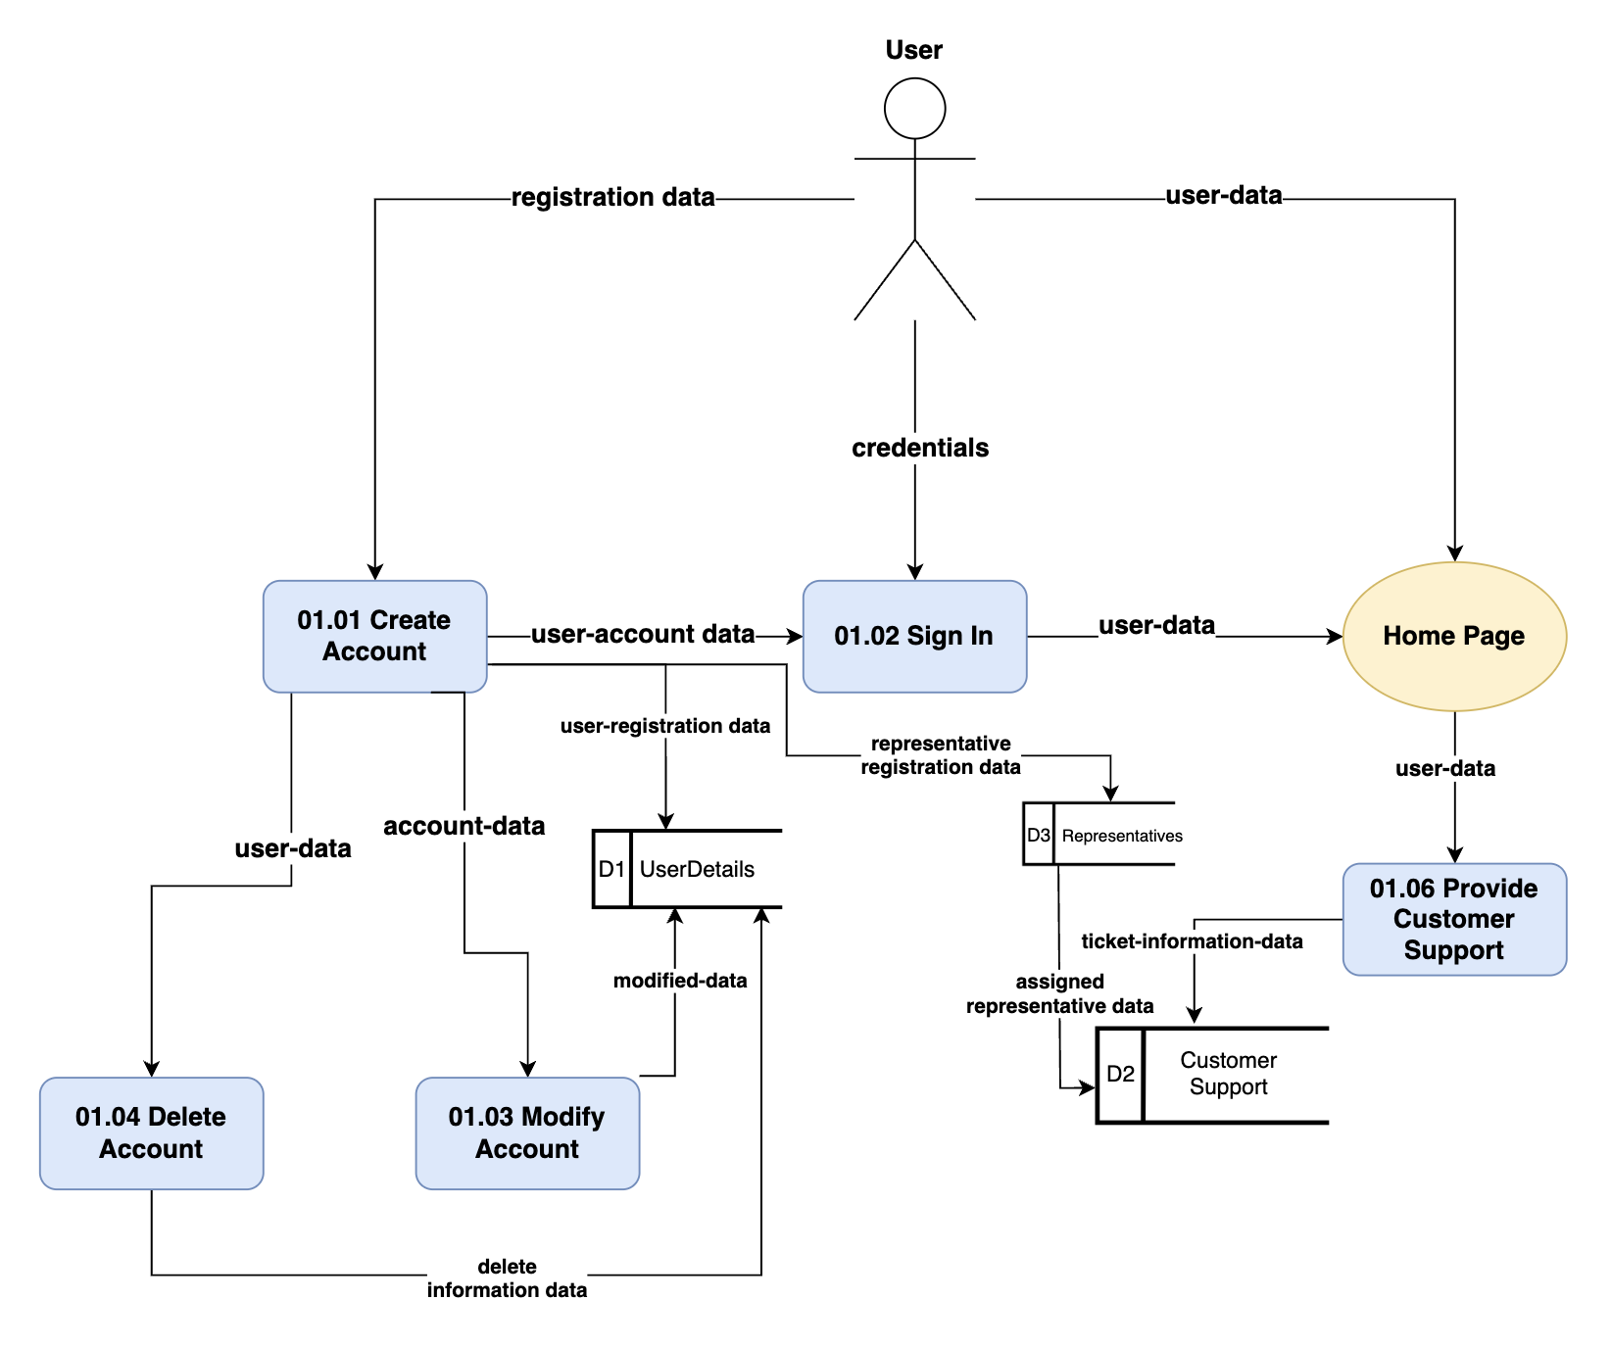
Team4 - Reviewer
Data Flow Diagram (Physical)

